Slide 1
Secure Data Hiding in Image Using Steganography
CAPSTONE PROJECT
Presented By:
Student Name : Anshika Dwivedi
College Name : Pranveer Singh Institute of Technology
Department : BTech (CSE – AIML)

Slide 2
OUTLINE
Problem Statement
Technology used
Wow factor
End users
Result
Conclusion
Git-hub Link
Future scope

Slide 3
Problem Statement
Traditional encryption secures data but does not hide its very existence, making secret communications vulnerable. This project addresses the challenge by concealing confidential messages within ordinary images. By subtly modifying pixel values, it ensures that the hidden data remains undetectable while the image appears unchanged. This stealthy approach is essential for secure communication in sensitive environments.

Slide 4
Technology used
Programming Language:
Python (Version 3.6+ for optimal performance)
Libraries:
Pillow (PIL): Used for opening, processing, and saving images.
NumPy: Employed for efficient pixel-level array manipulation.
Tools & Version Control:
Git: Used for source code management and version control.
Development Environment:
IDEs (Optional): Visual Studio Code, PyCharm, etc.
Operating Systems: Cross-platform support (Windows, Linux, MacOS).

Slide 5
Wow factors
Dual Security Approach: Combines covert data embedding with robust encryption techniques.
Imperceptible Modifications: Ensures that the image’s appearance remains intact despite hidden data.
User-Centric Design: Intuitive functions for encoding and decoding with a clear workflow.
Comprehensive Integration: Easily incorporated into existing secure communication systems.

Slide 6
End users
Cybersecurity Professionals: Secure communication and data protection.
Corporate & Government Agencies: For confidential data transfer and secure archives.
Academic Institutions: As a teaching and research tool in digital security.
Developers & Tech Enthusiasts: To explore, extend, and innovate within the realm of steganography.

Slide 7


Results
Original image vs. steganographic image (side-by-side).

Slide 8
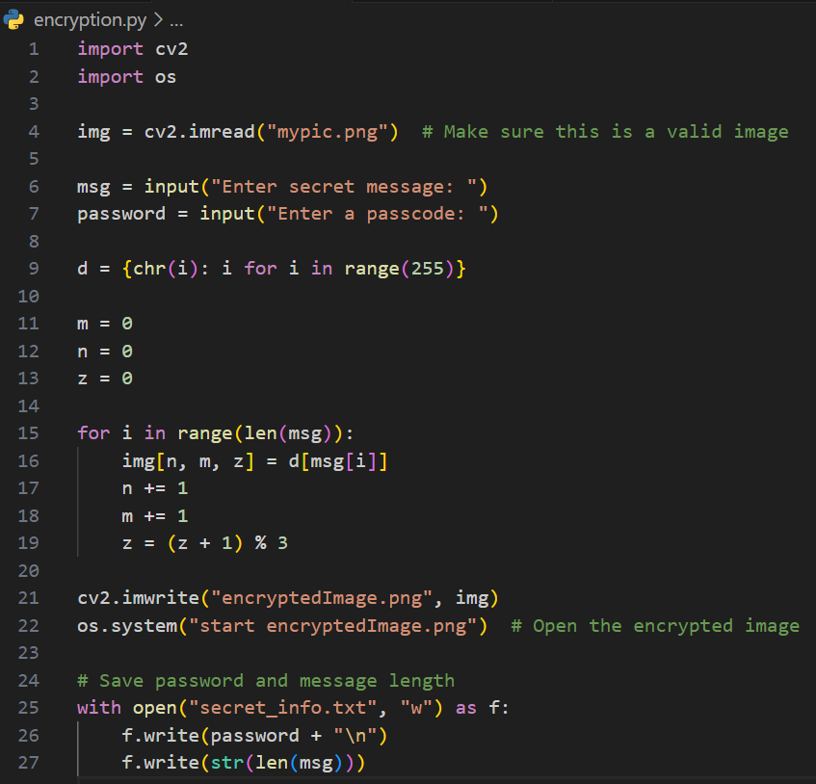
Interface displaying the encoding process.

Slide 9
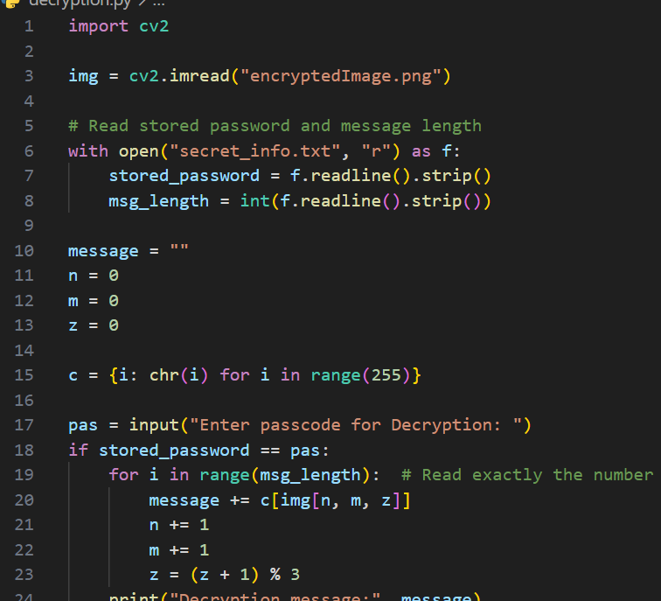
Decoding process revealing the hidden message.

Slide 10
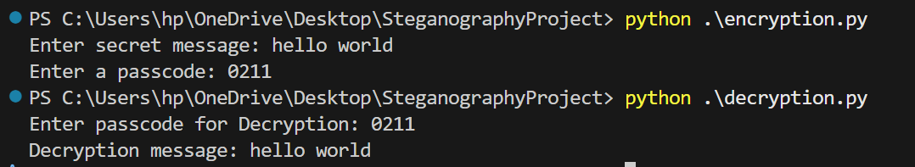

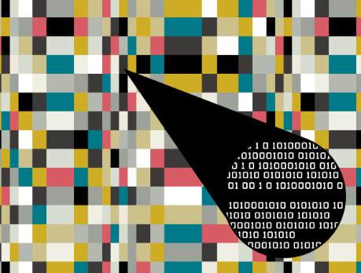

Slide 11
Conclusion
This project successfully demonstrates a secure method to embed and extract secret messages within images. By leveraging Python along with powerful libraries like Pillow and NumPy, it achieves high data concealment without compromising image quality. Its simplicity, robustness, and scalability make it a valuable tool for secure communications.

Slide 12
GitHub Link
Access the complete project repository here: https://github.com/anshika020904/Secure-Data-Hiding-in-Image-Using-Steganography.git (The repository includes a detailed README with installation and usage instructions.)

Slide 13
Future scope
Enhanced Encryption: Integration of AES or other advanced encryption techniques.
Graphical User Interface: Development of an interactive, user-friendly GUI.
Multimedia Expansion: Extend support to video and audio steganography.
Robustness Improvements: Refinement of algorithms to resist advanced detection and steganalysis methods.

Slide 14
THANK YOU

